Slide 1
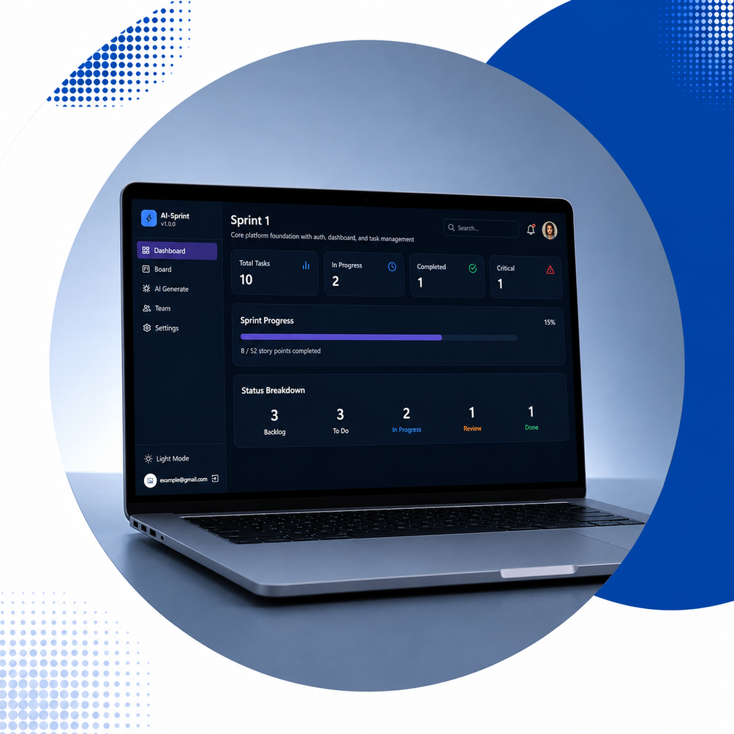






AI SPRINT PLATFORM
AGILE PROJECT MANAGEMENT PLATFORM
Team Members
Abdelrahman Amin
Ali Mohamed
Yasser Mohamed
Shams Emam
Khadija Medhat

Slide 2

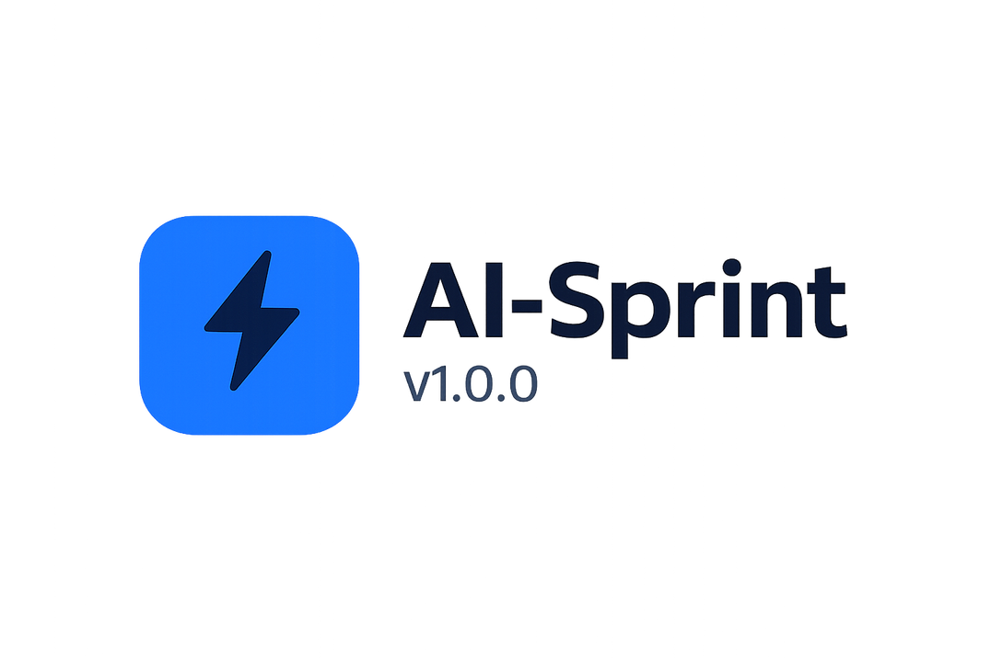
01
Project Overview
Introduction
Problem Statement
Existing Solutions
Our Solution (AI-Sprint)
Use Case Diagram
Agenda
02
System Design
Technology Stack
System Architecture
03
System Implementation
Dashboard
Kanban Board
AI Assistant
Team Management
Settings
Authentication
04
Results & Future Work
Results / Demo
Future Work
05
Conclusion
Conclusion

Slide 3
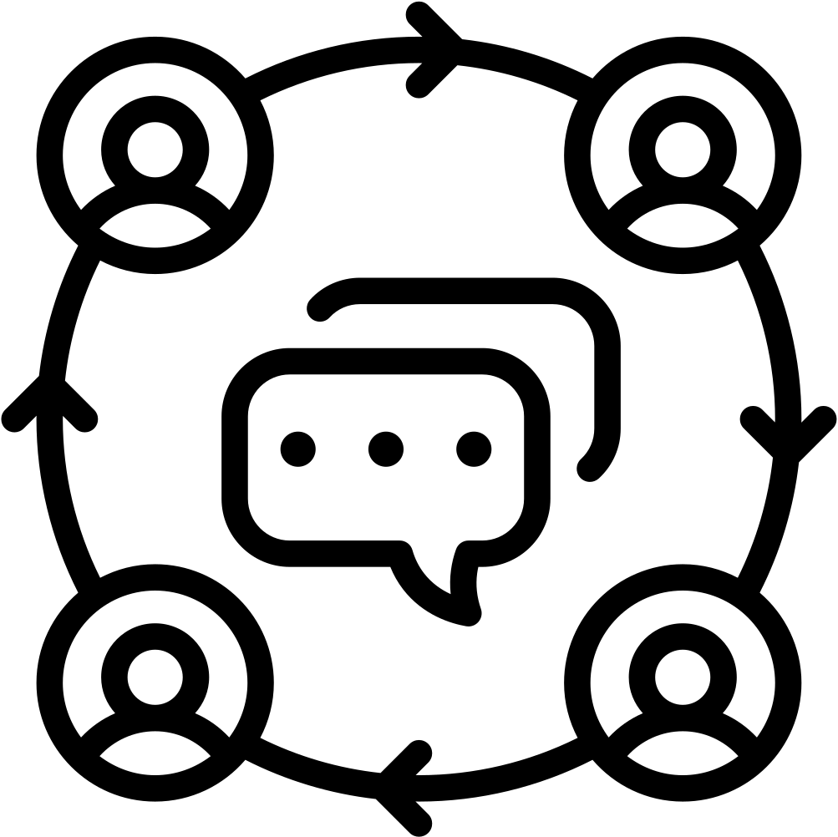
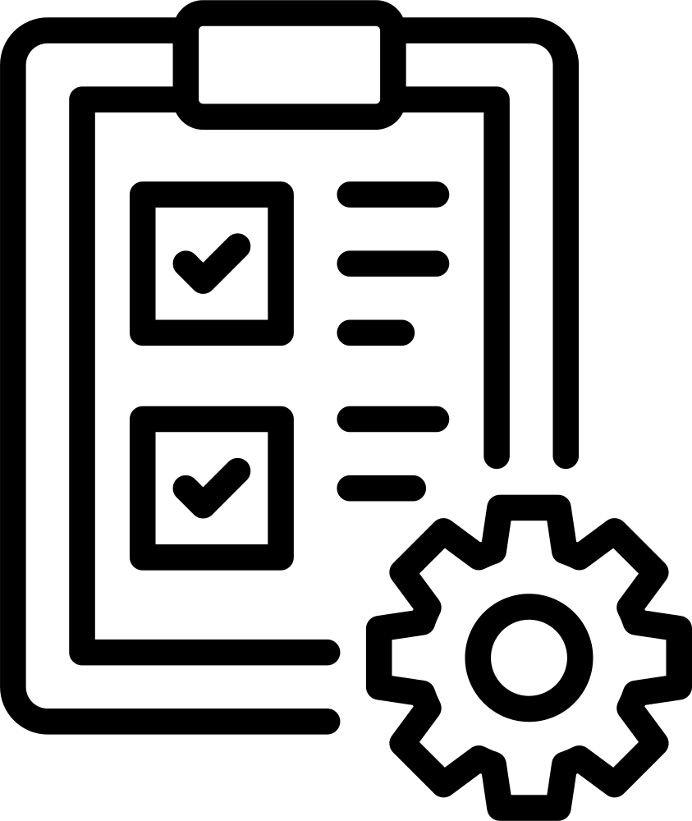


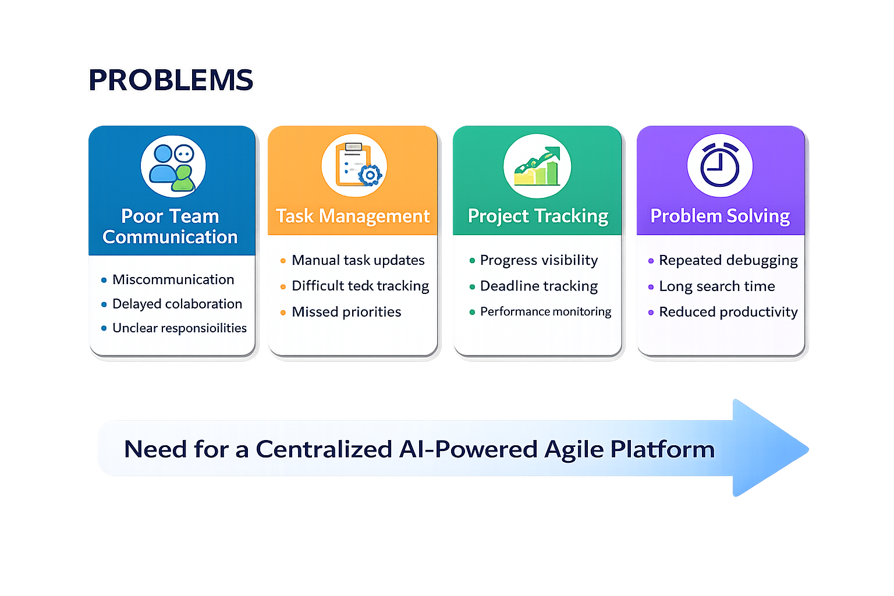
WHY AI-SPRINT?
Poor
Communication
Task
Management
Poor
Project Tracking
Problem
Solving
Miscommunication
Delayed collaboration
Unclear responsibilities
Manual task updates
Difficult task tracking
Missed priorities
No progress visibility
Missed deadlines
Hard performance tracking
Repeated debugging
Long search time
Reduced productivity

Slide 4
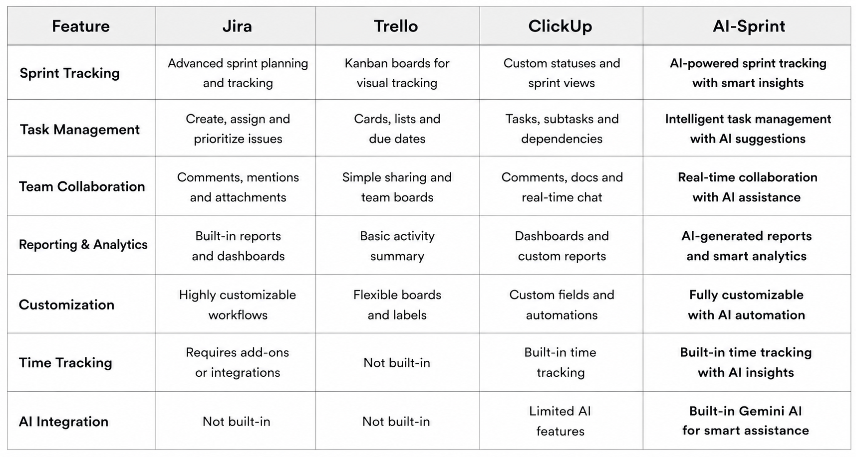
EXISTING SOLUTIONS

Slide 5



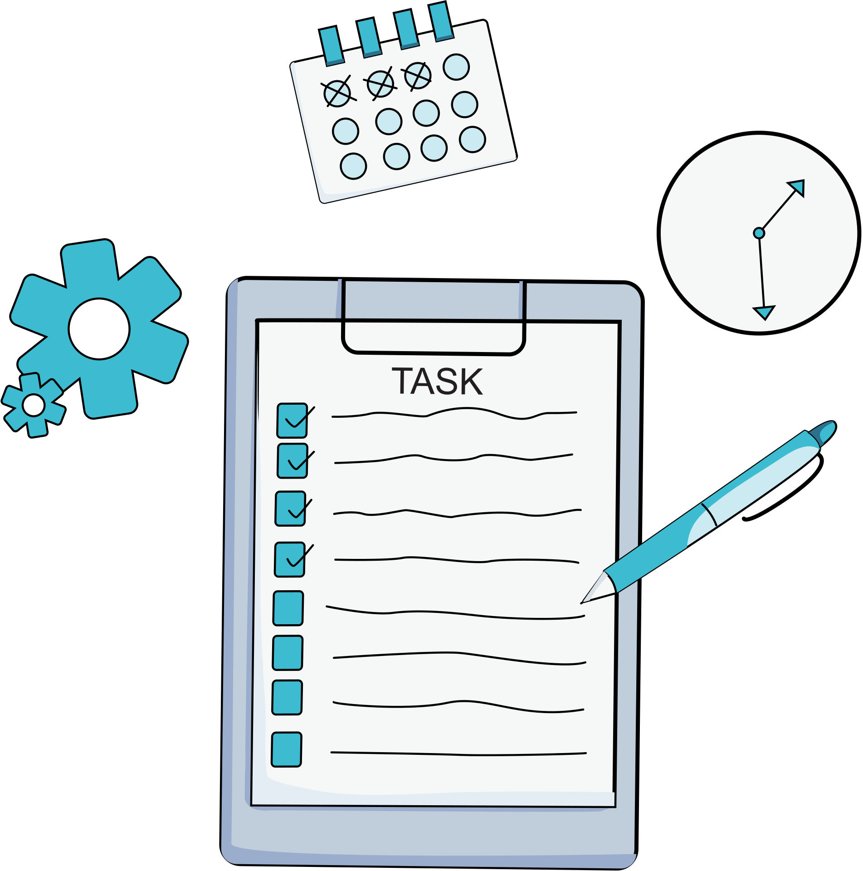



OUR SOLUTION
Team Collaboration
Assign And Manage
Team Members
Task Management
Create, Update
And Track Tasks
Gemini AI
AI Assistance And
Smart Suggestions
Sprint Tracking
Monitor Progress
And Performance

Slide 6









SYSTEM OVERVIEW
Dashboard
Sprint overview
Progress tracking
Statistics & reports
Activity summary
Kanban Board
Create & manage tasks
Drag & drop workflow
Task status tracking
Sprint organization
Team Management
Manage team members
Assign roles & permissions
Workload tracking
Team collaboration
Settings
Profile & account settings
Theme (Dark / Light)
Preferences
Notifications
Gemini AI Assistant
Smart suggestions
Code assistance
Problem solving help
Task insights

Slide 7
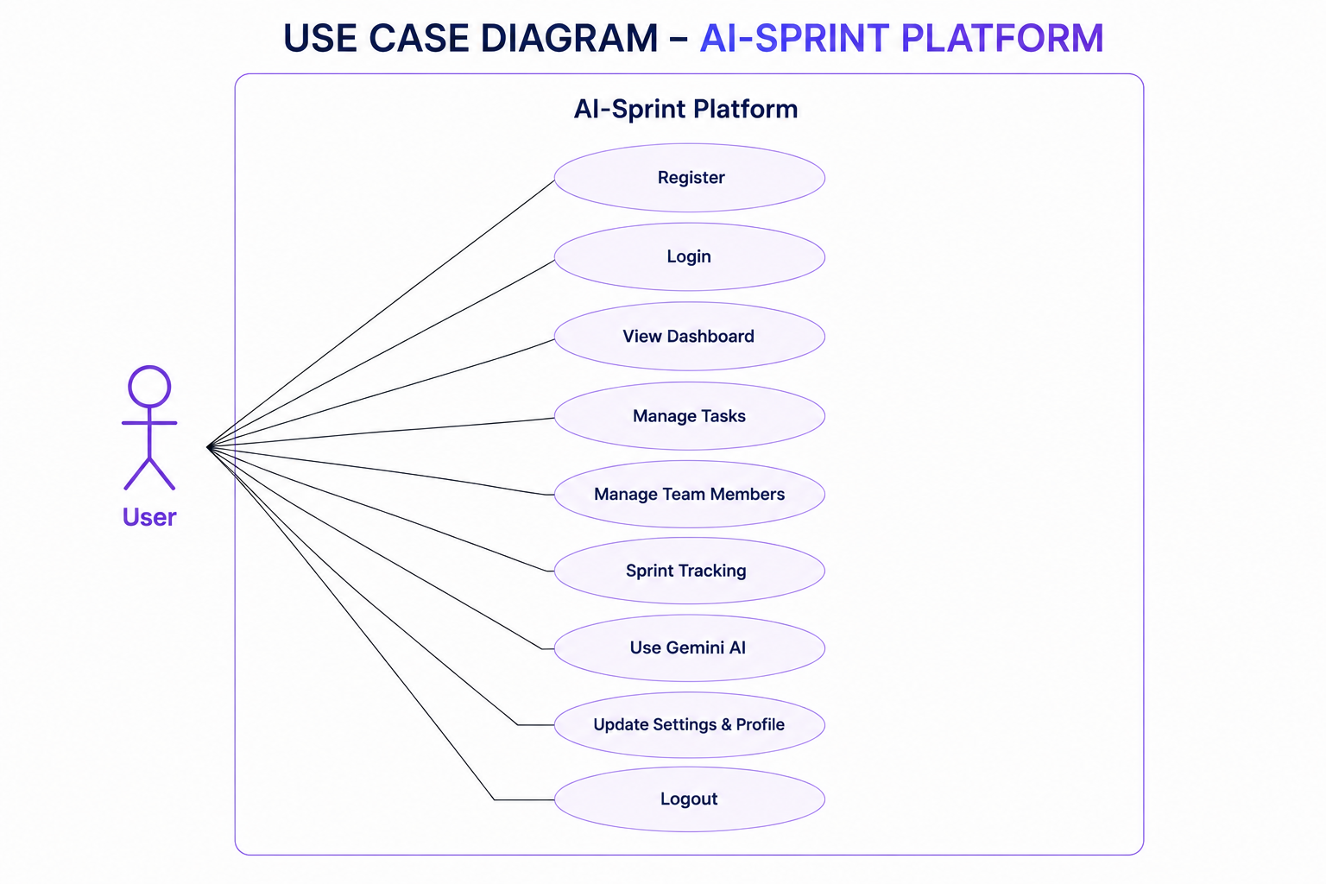
USE CASE DIAGRAM

Slide 8
01
Project Overview
Introduction
Problem Statement
Existing Solutions
Our Solution (AI-Sprint)
Use Case Diagram
Agenda
02
System Design
Technology Stack
System Architecture
03
System Implementation
Dashboard
Kanban Board
AI Assistant
Team Management
Settings
Authentication
04
Results & Future Work
Results / Demo
Future Work
05
Conclusion
Conclusion

Slide 9

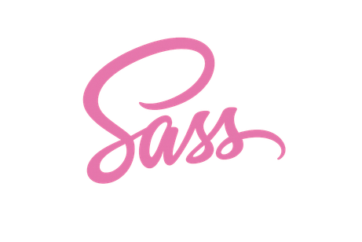

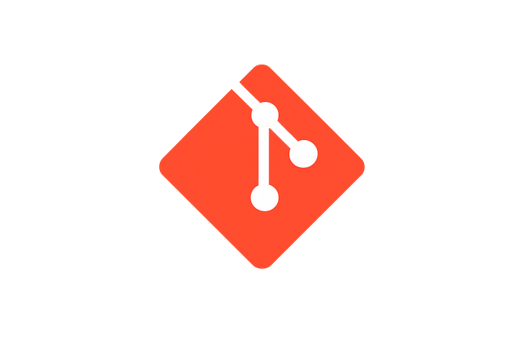
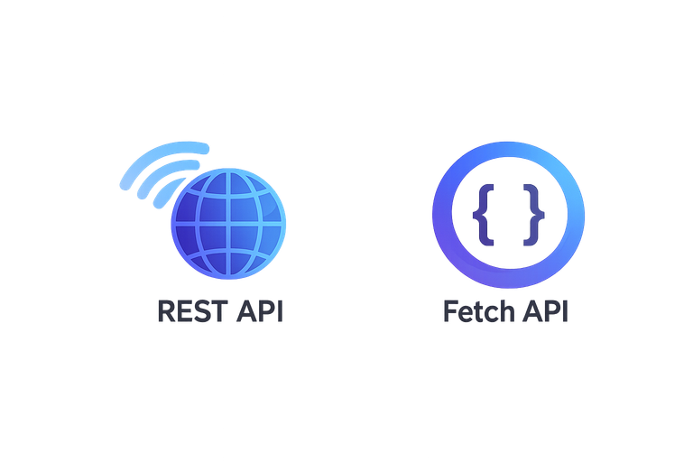
TECHNOLOGY STACK
Front-End
Back-End
Database
React
Sass
Boot Strap
AI Assistant
Version Control
Api
Gemini
Git hub
Git

Slide 10
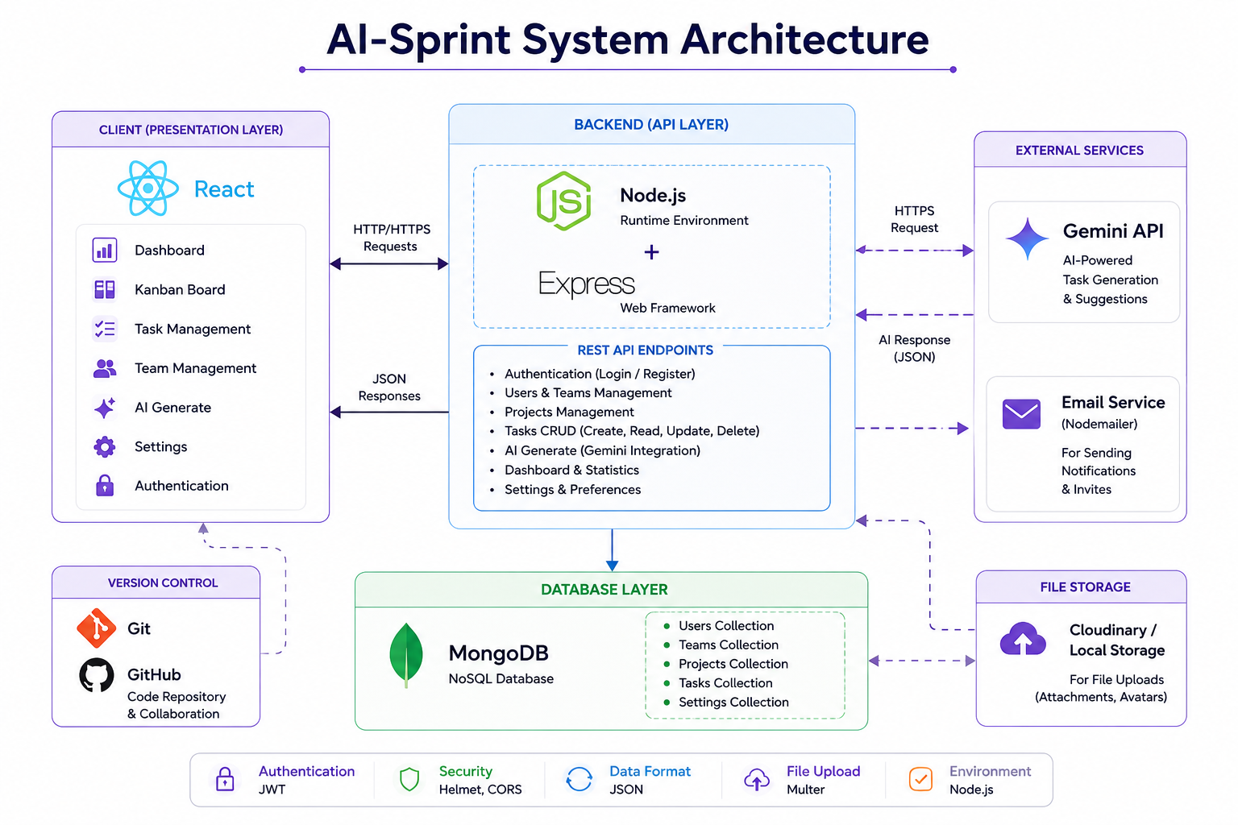

Slide 11
01
Project Overview
Introduction
Problem Statement
Existing Solutions
Our Solution (AI-Sprint)
Use Case Diagram
Agenda
02
System Design
Technology Stack
System Architecture
03
System Implementation
Dashboard
Kanban Board
AI Assistant
Team Management
Settings
Authentication
04
Results & Future Work
Results / Demo
Future Work
05
Conclusion
Conclusion

Slide 12
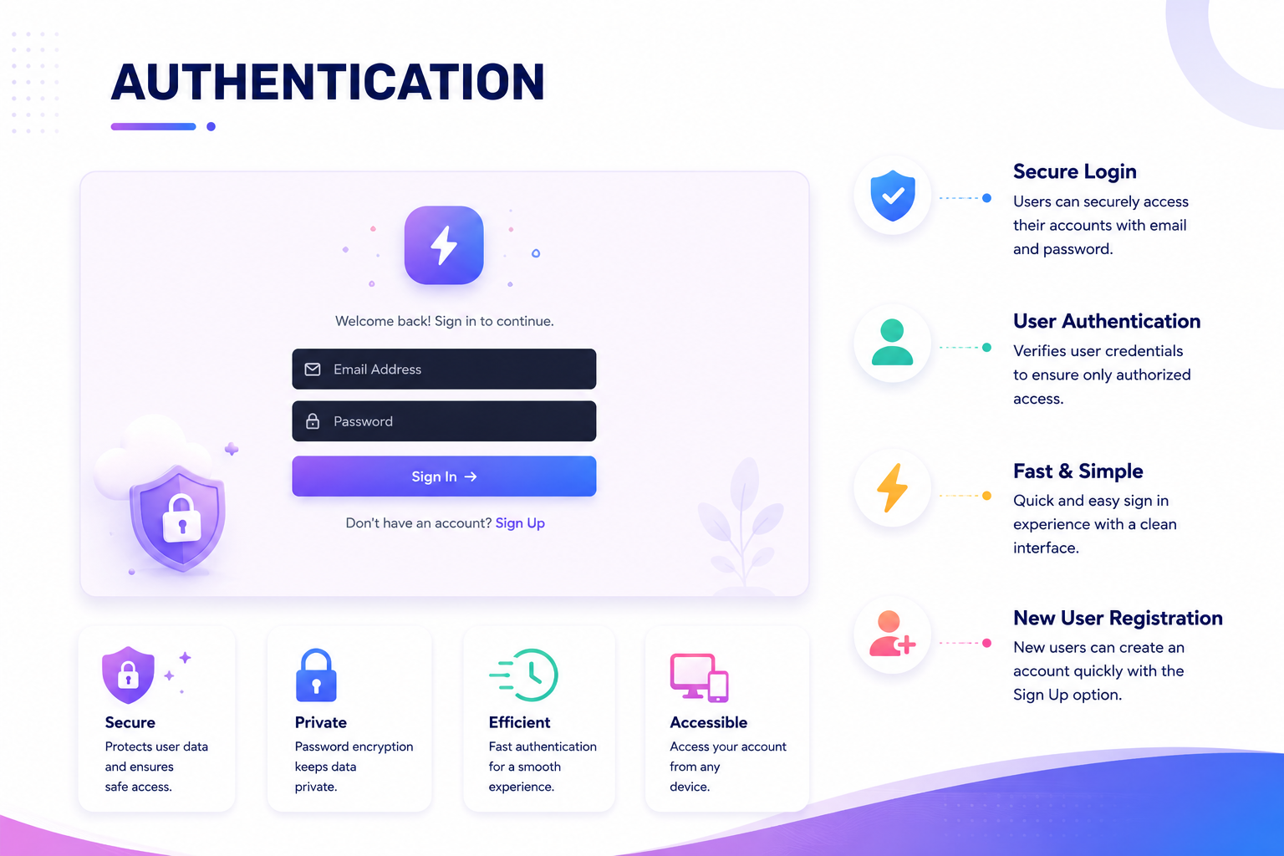
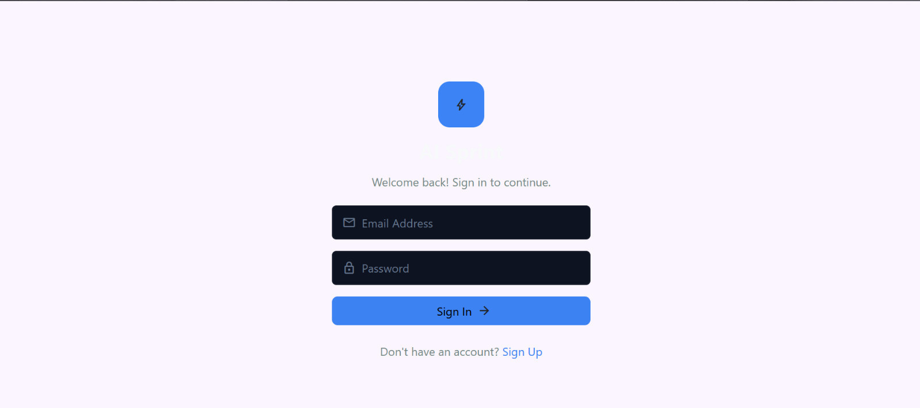
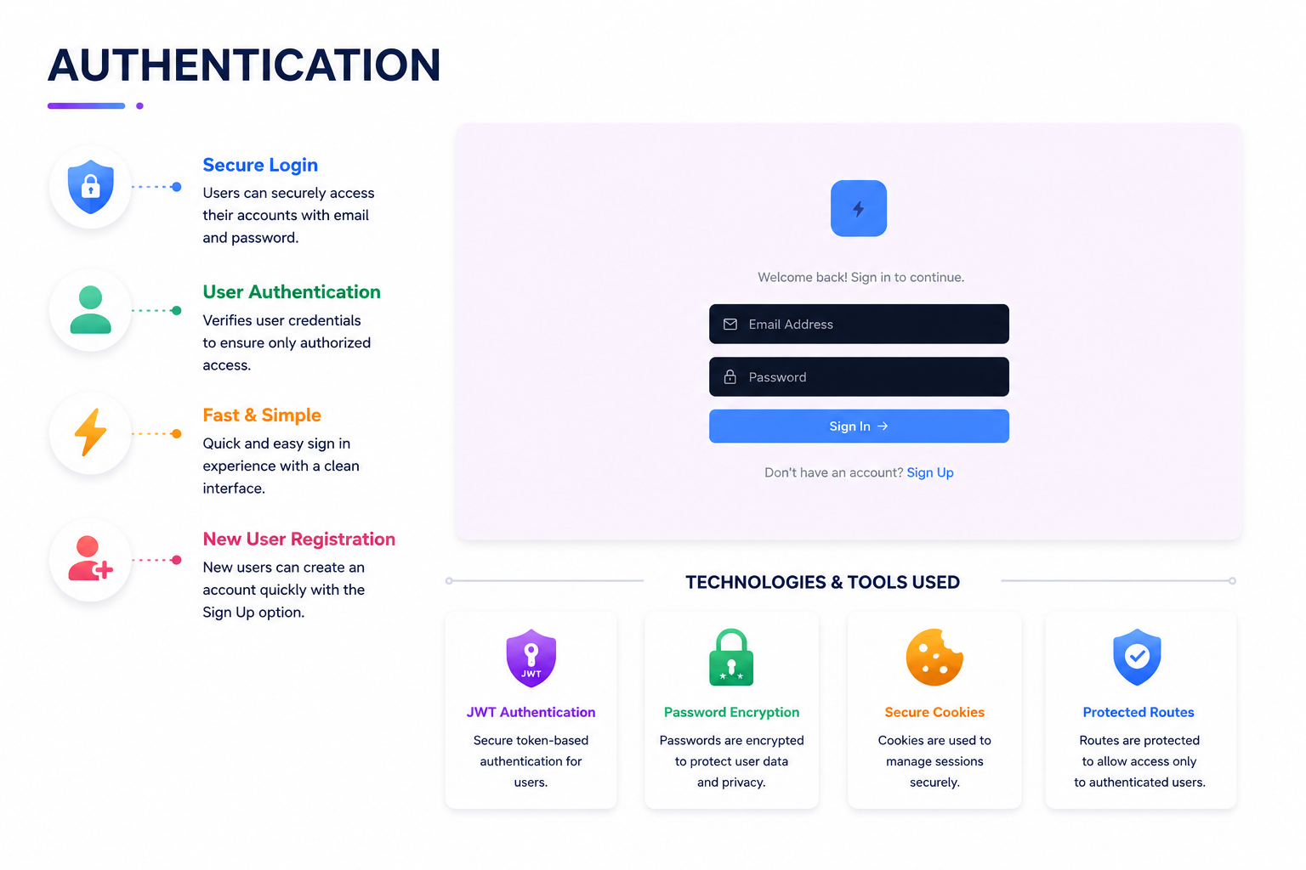
AUTHENTICATION

Slide 13
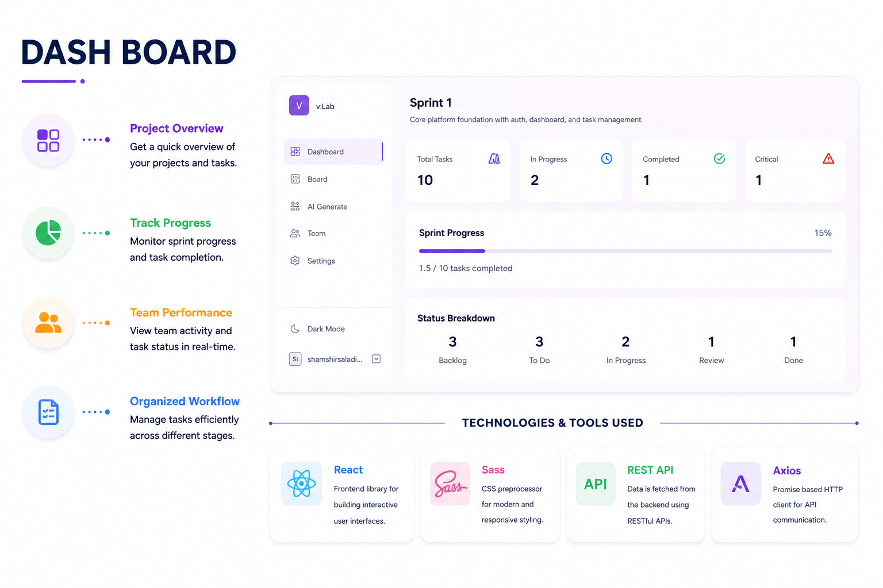
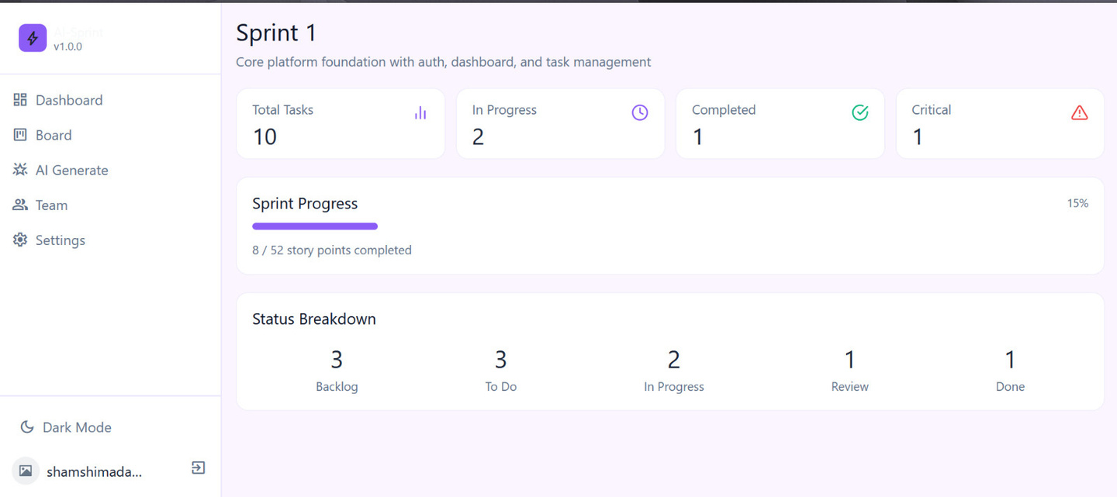
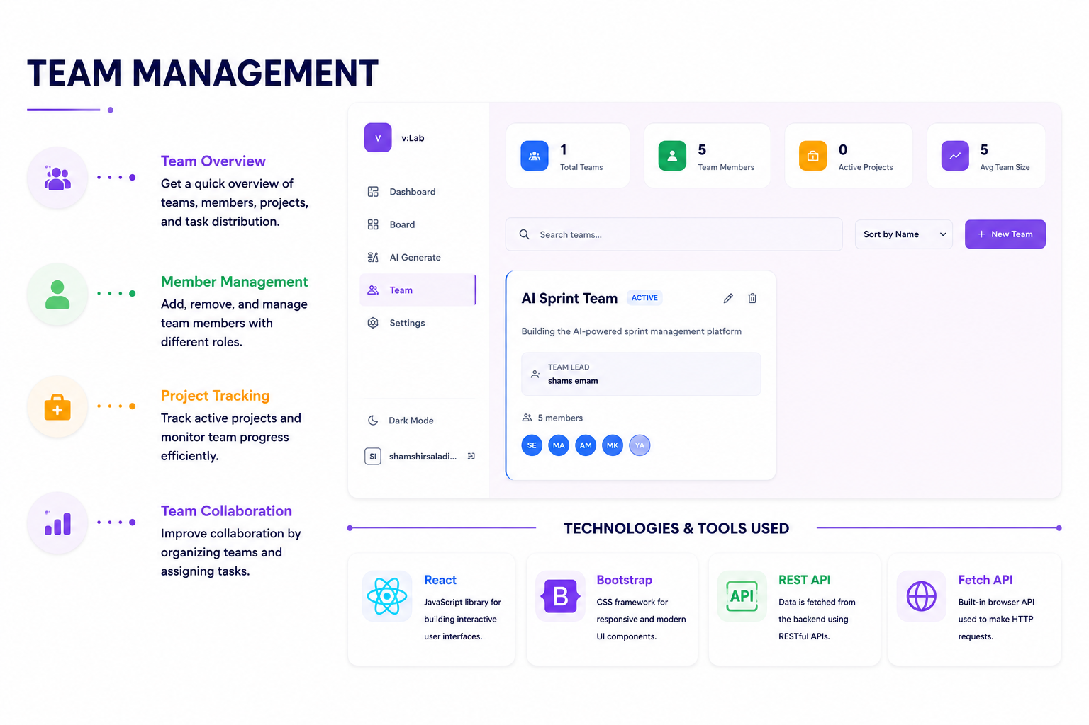
DASH BOARD

Slide 14
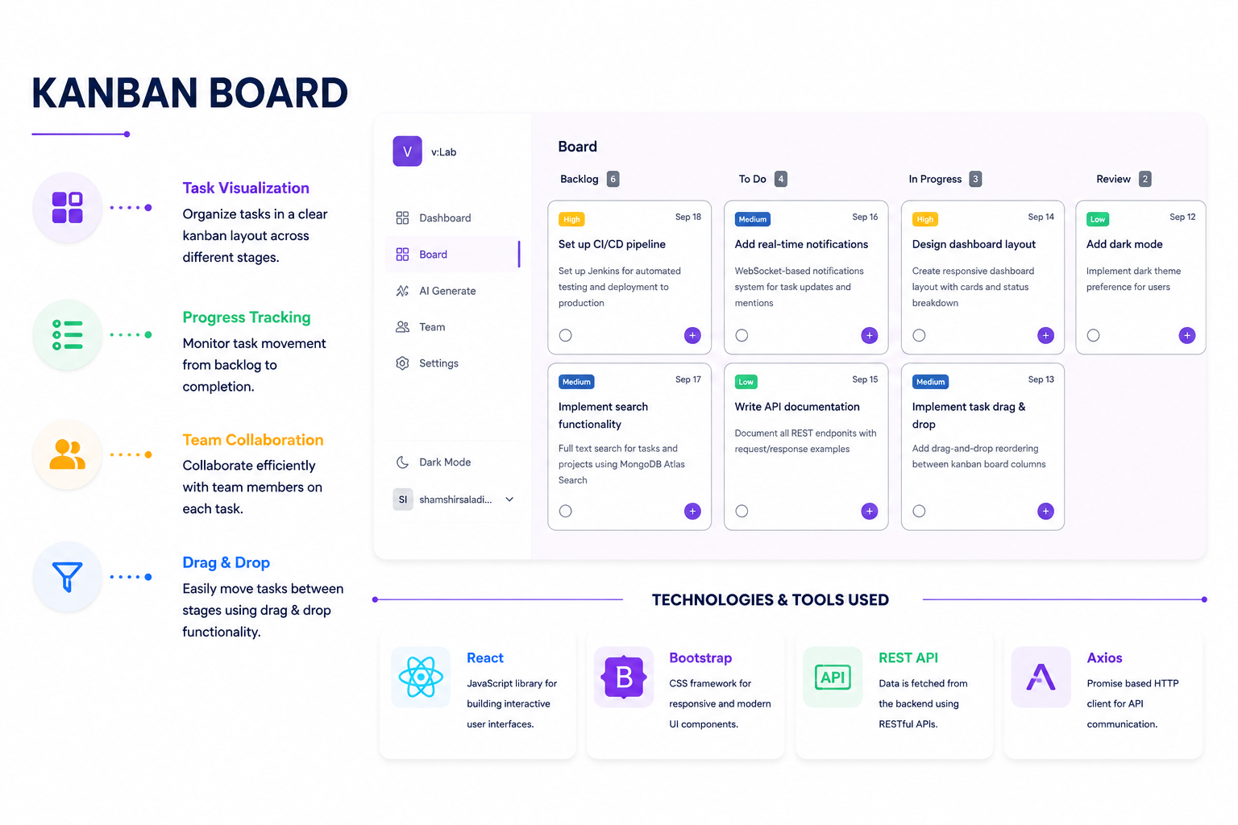
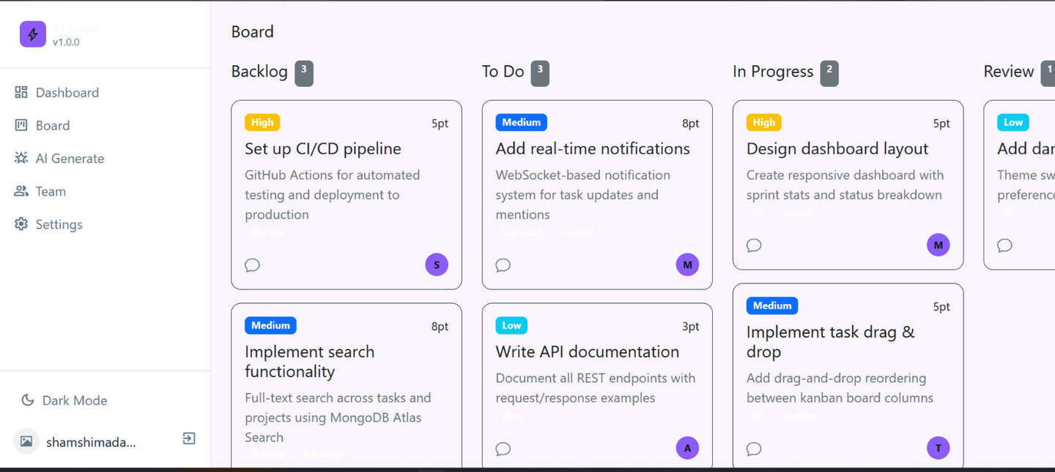
KANBAN BOARD

Slide 15
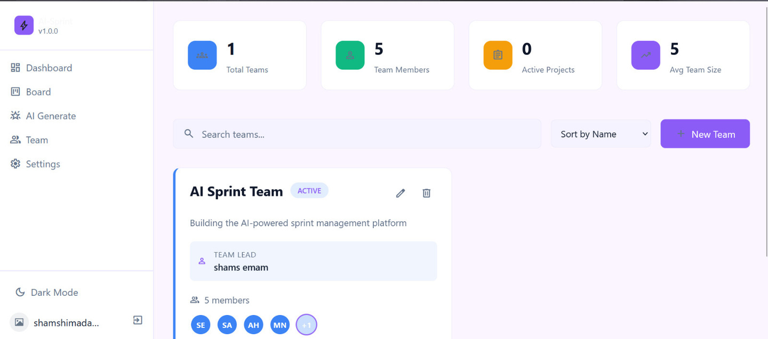
TEAM MANAGEMENT

Slide 16
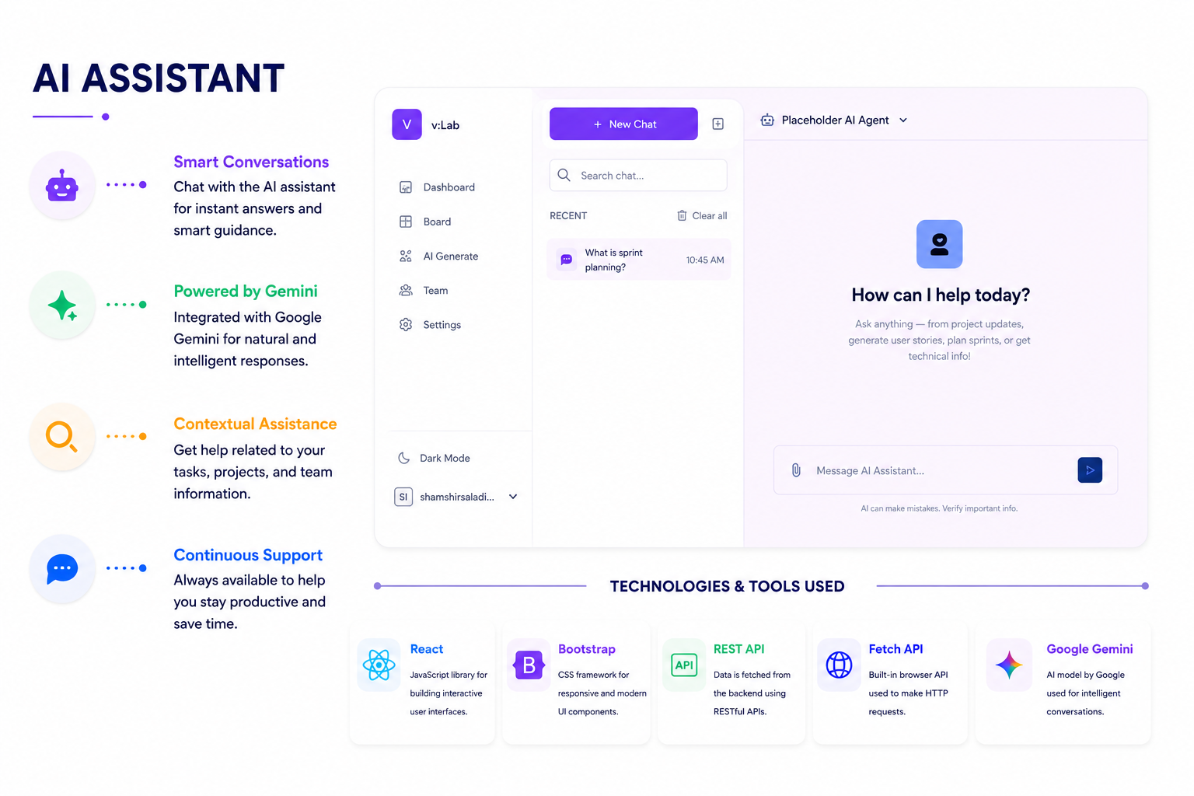
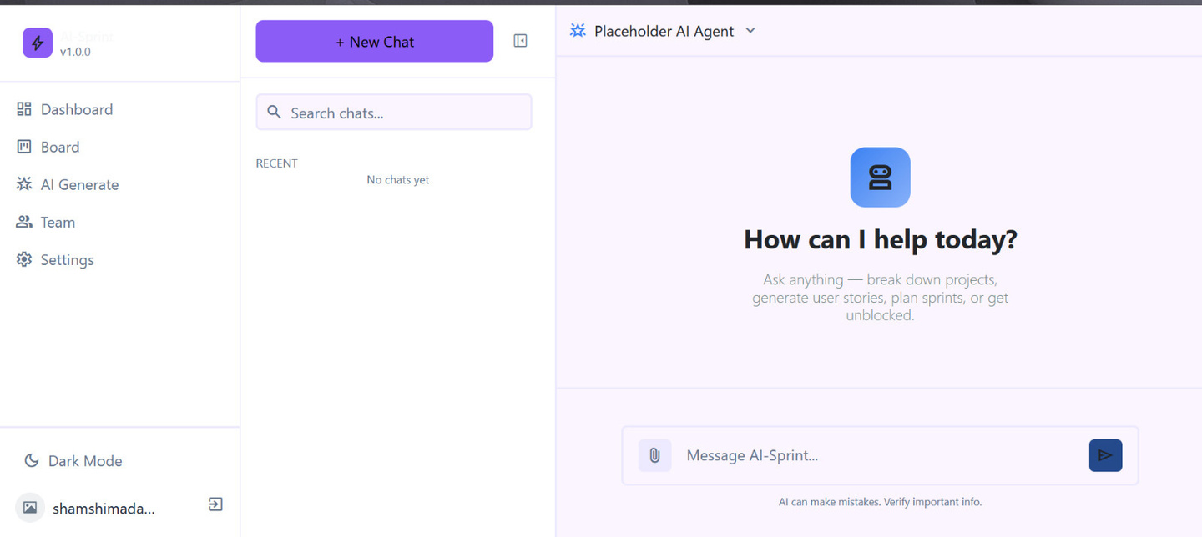
AI ASSISTANT

Slide 17
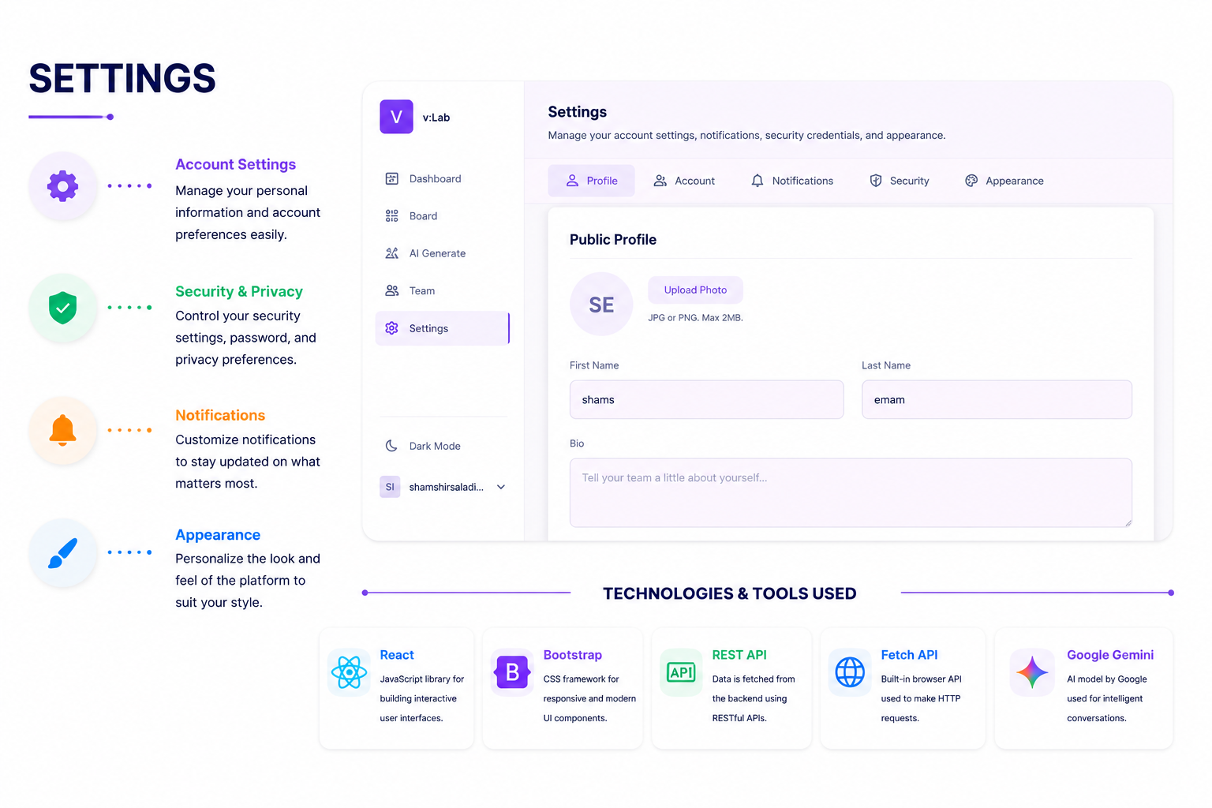
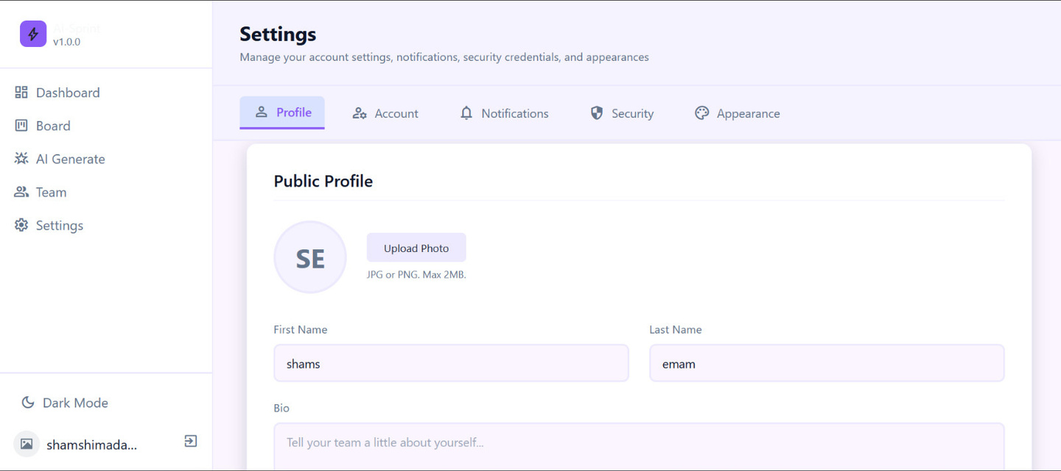
SETTINGS

Slide 18
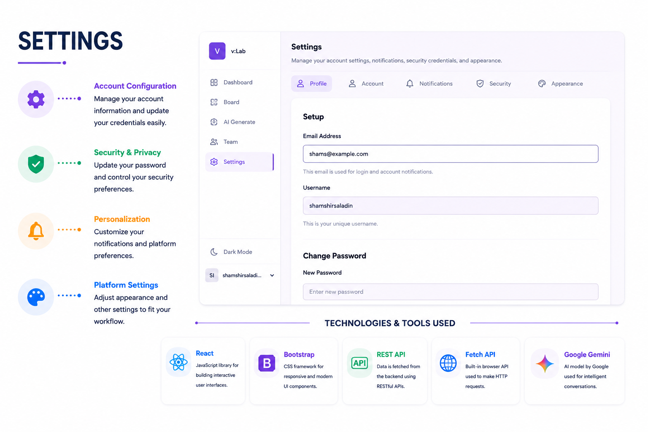
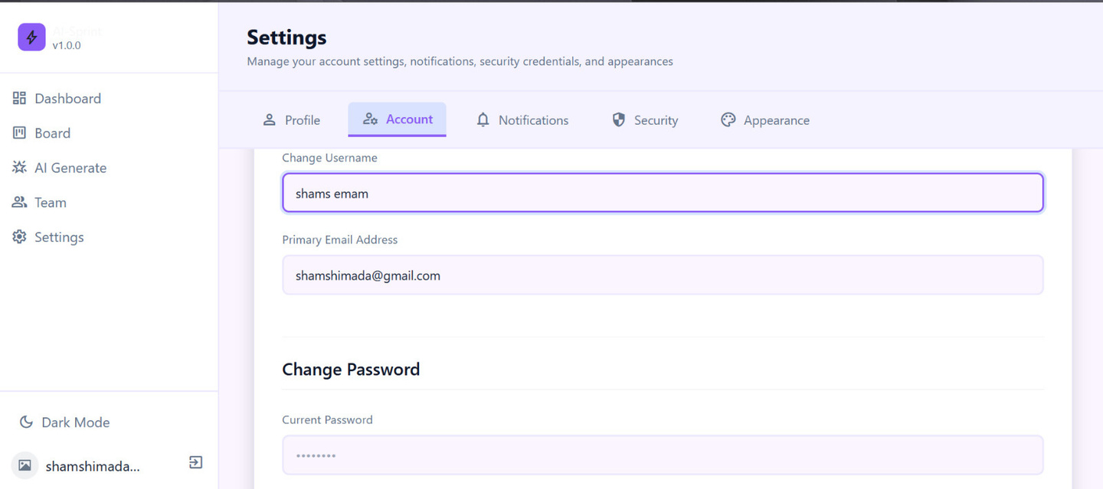
SETTINGS

Slide 19
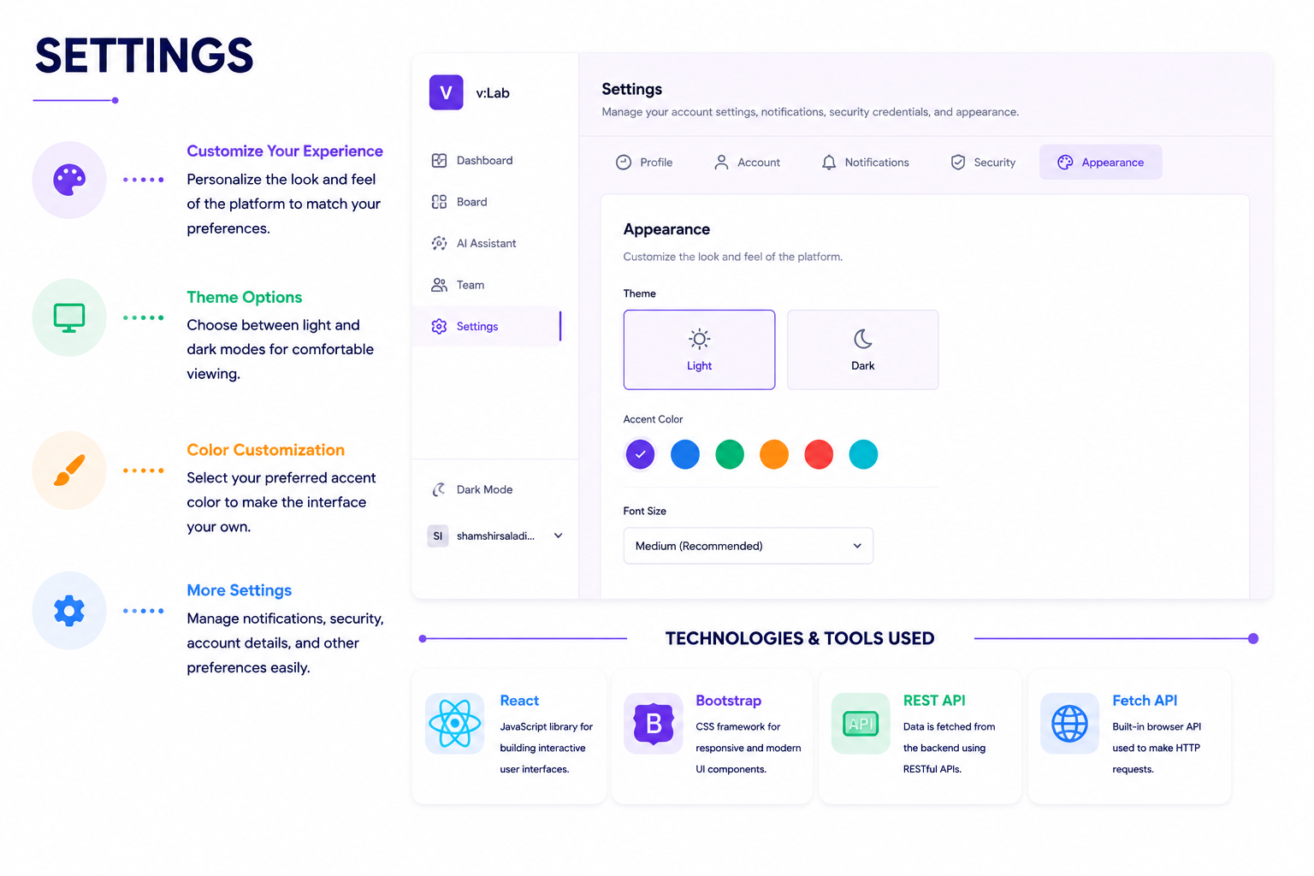
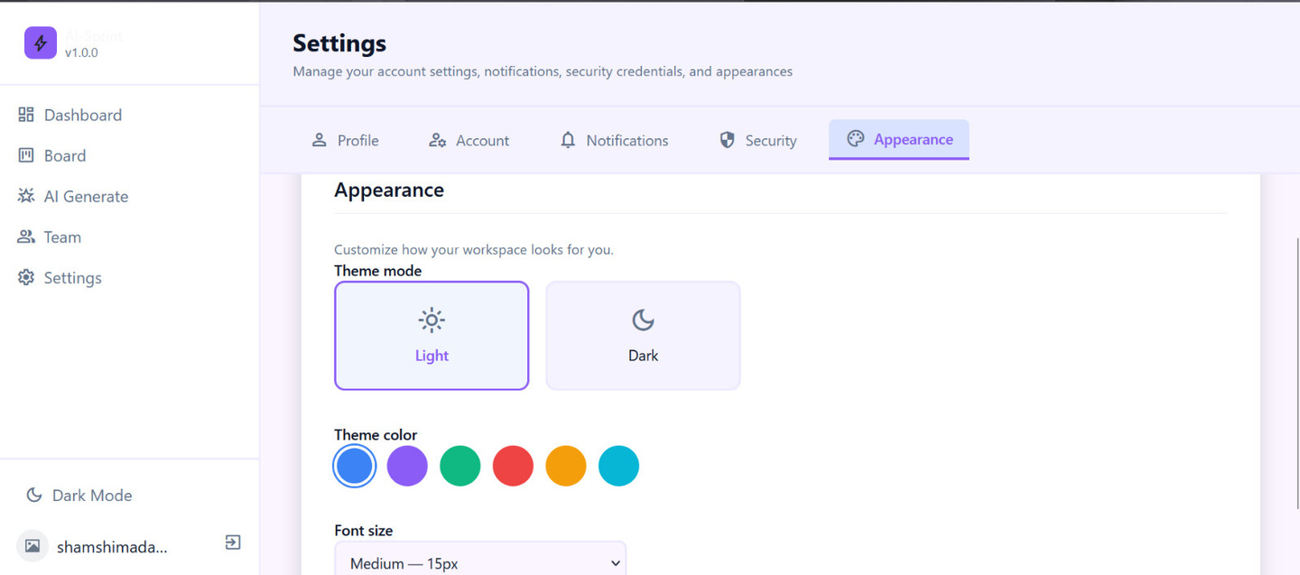
SETTINGS

Slide 20
01
Project Overview
Introduction
Problem Statement
Existing Solutions
Our Solution (AI-Sprint)
Use Case Diagram
Agenda
02
System Design
Technology Stack
System Architecture
03
System Implementation
Dashboard
Kanban Board
AI Assistant
Team Management
Settings
Authentication
04
Results & Future Work
Results / Demo
Future Work
05
Conclusion
Conclusion

Slide 21
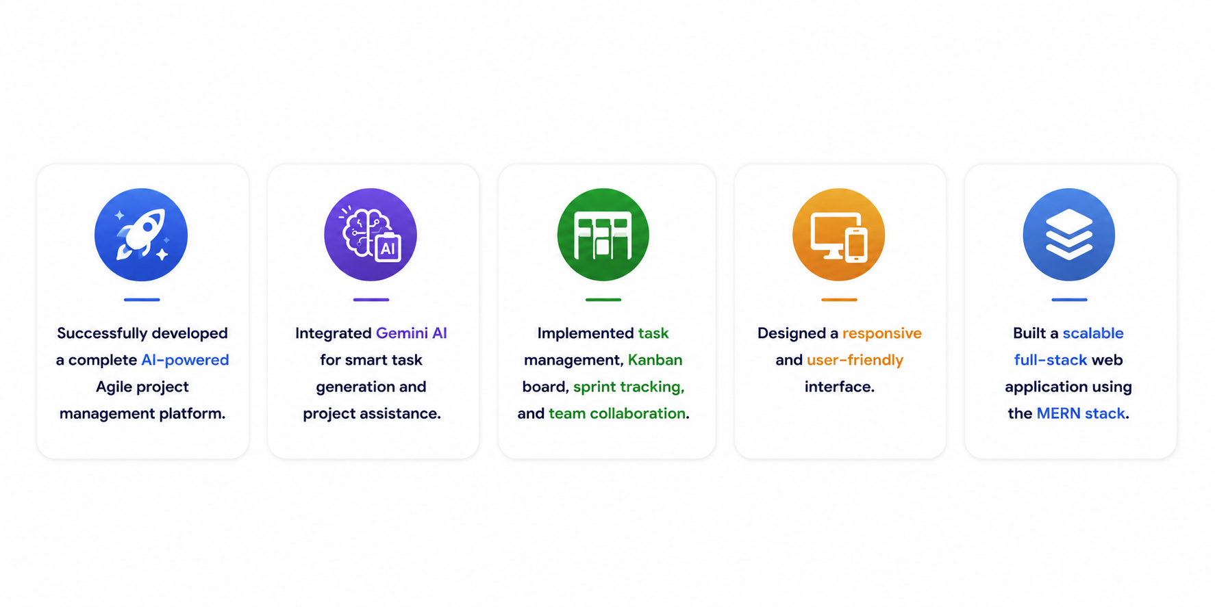
RESULTS

Slide 22
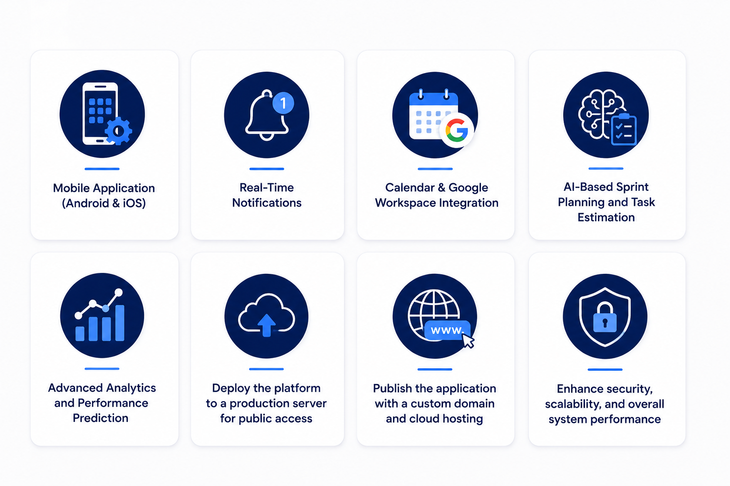
FUTURE WORK

Slide 23
01
Project Overview
Introduction
Problem Statement
Existing Solutions
Our Solution (AI-Sprint)
Use Case Diagram
Agenda
02
System Design
Technology Stack
System Architecture
03
System Implementation
Dashboard
Kanban Board
AI Assistant
Team Management
Settings
Authentication
04
Results & Future Work
Results / Demo
Future Work
05
Conclusion
Conclusion

Slide 24
CONCLUSION
AI-Sprint successfully integrates task management, sprint tracking, team collaboration, and AI-powered assistance into a single platform. By combining agile project management with Gemini AI, the system helps development teams work more efficiently, improve collaboration, and accelerate decision-making through smart task generation and project insights.

Slide 25
THANK YOU

